Slide 1
7FNCE040W
Business Analytics
WEEK 10
Support Vector Machines

Slide 2
Today’s Schedule
Support Vector Machines
Chapter 9
Group course work

Slide 3
What is Support Vector Machine (SVM) learning?
Support vector machine is another simple algorithm.
Support Vector Machine (SVM) is a classification and regression technique that is particularly suitable for wide datasets. A wide dataset is one with a large number of predictors, such as might be encountered in the field of bioinformatics (the application of information technology to biochemical and biological data).
The objective of the support vector machine algorithm is to find a hyperplane in an N-dimensional space(N — the number of features) that distinctly classifies the data points.

Slide 4
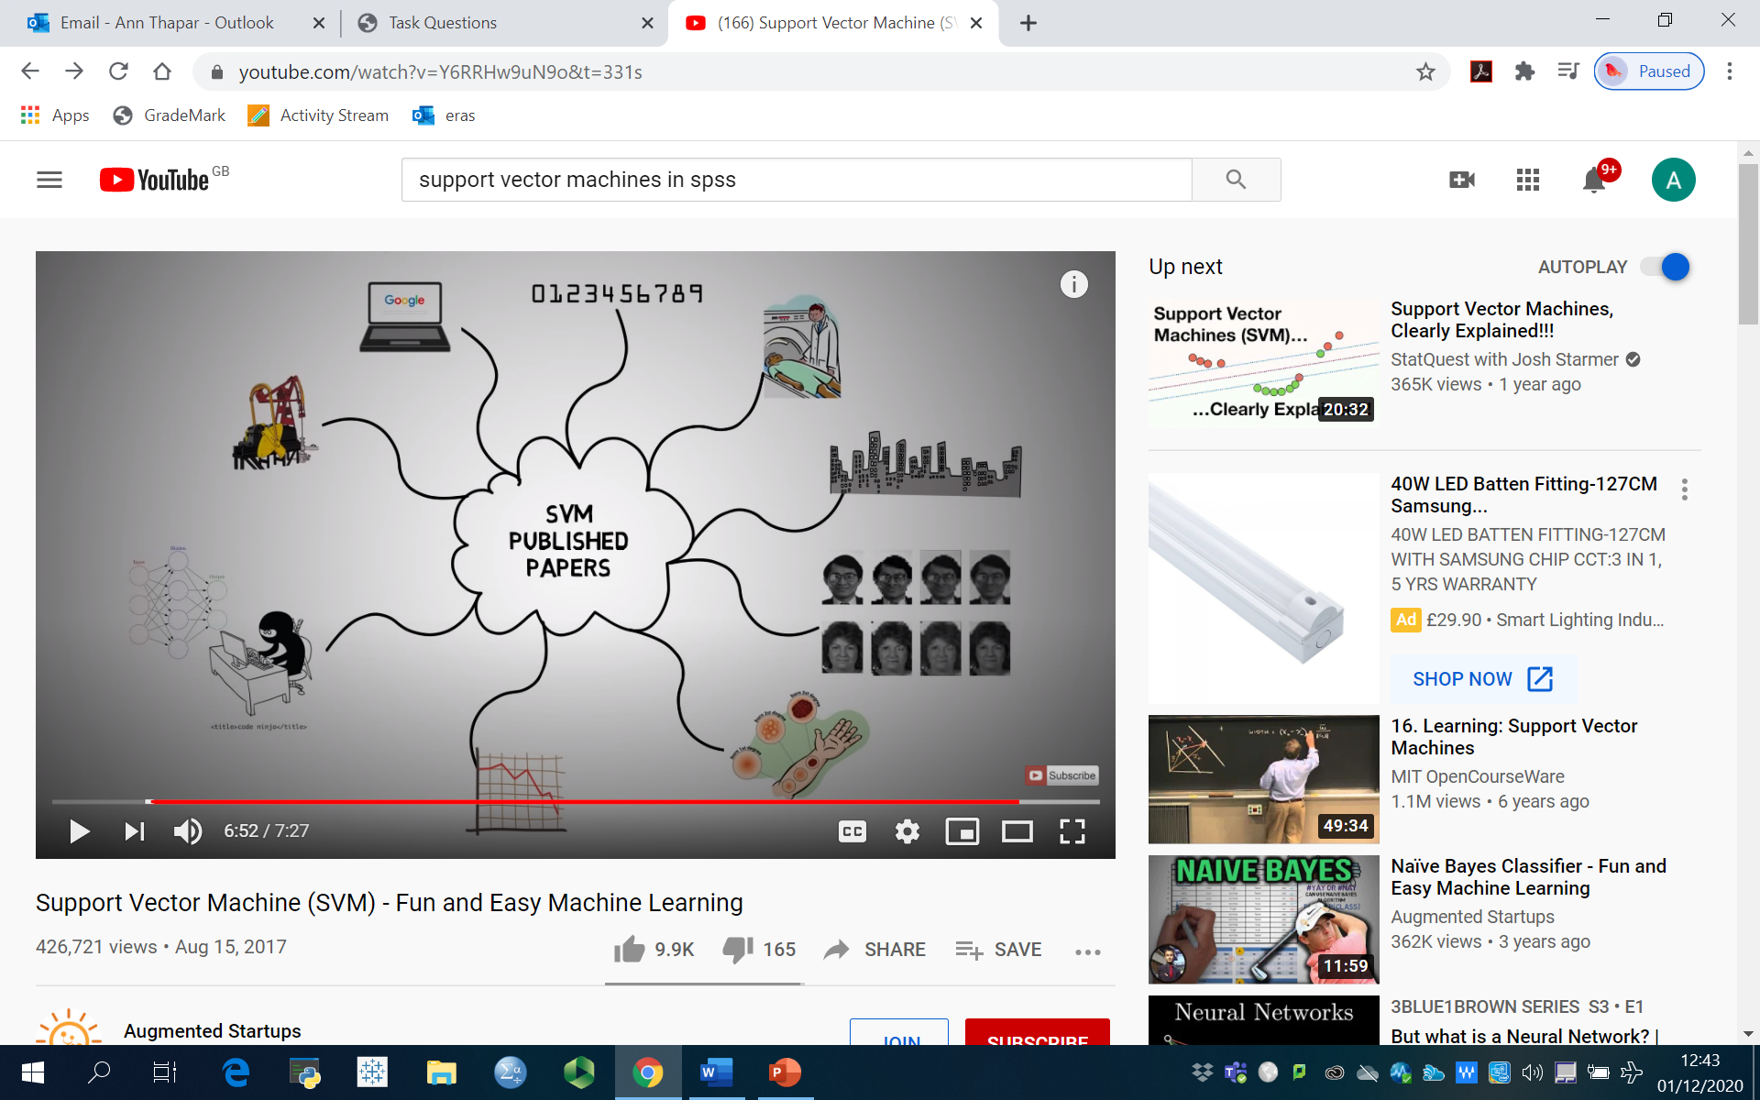
Applications of SVM

Slide 5
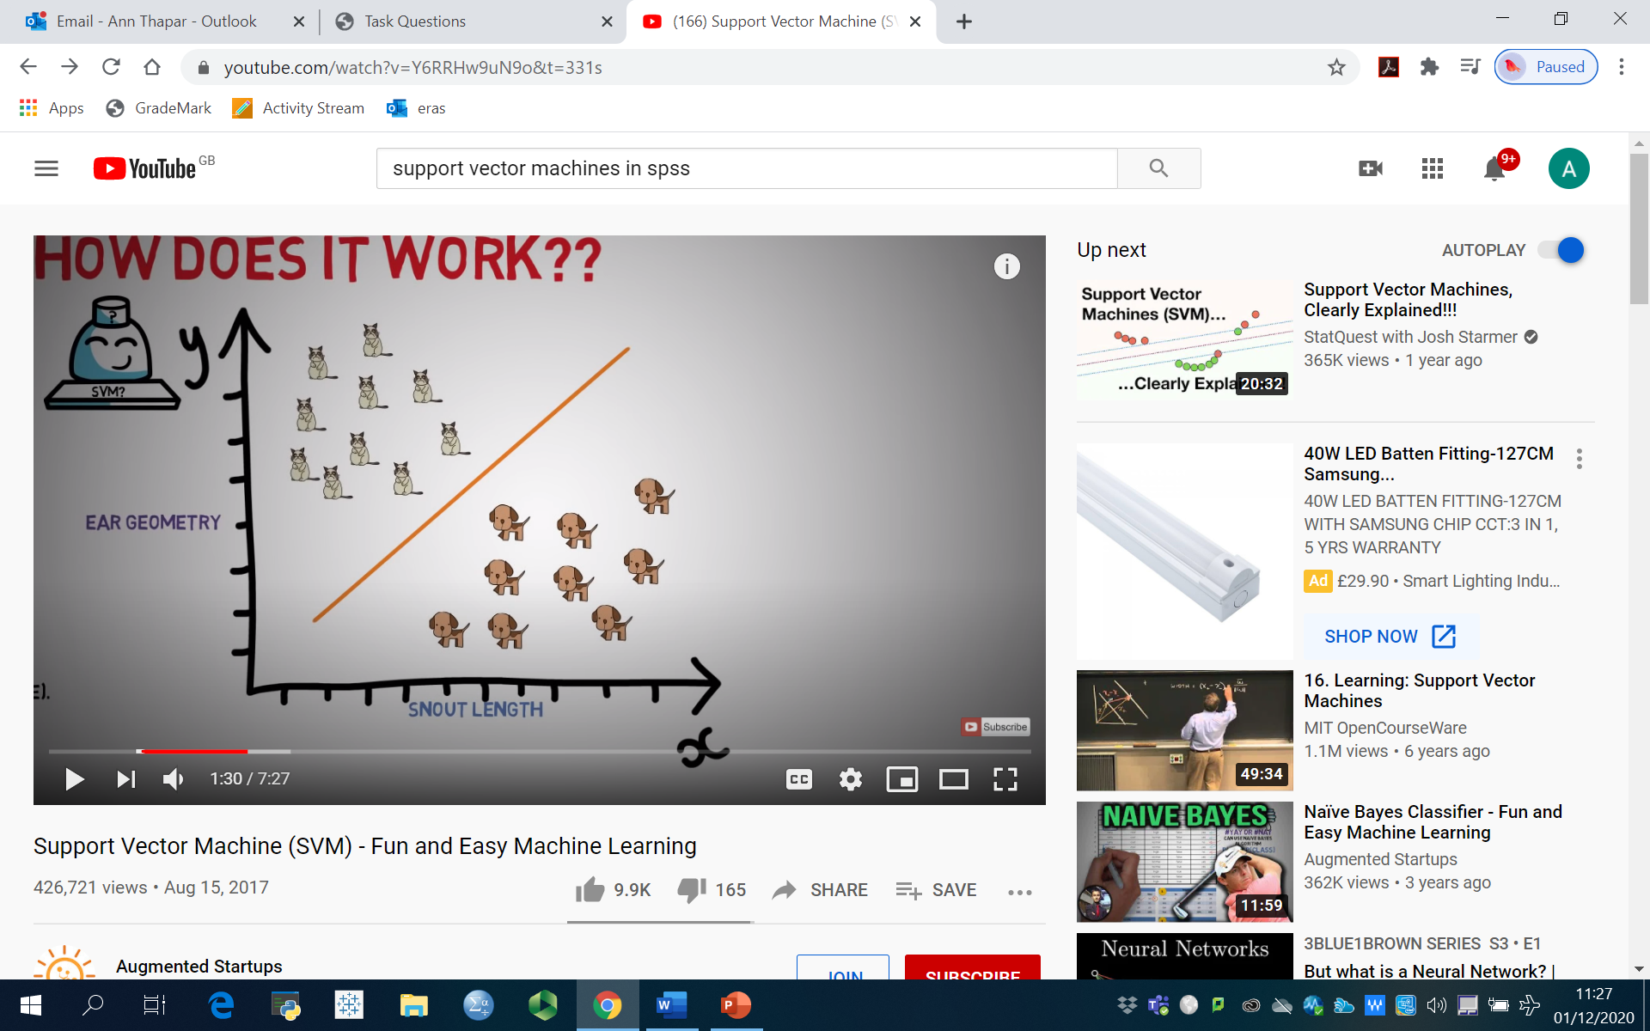
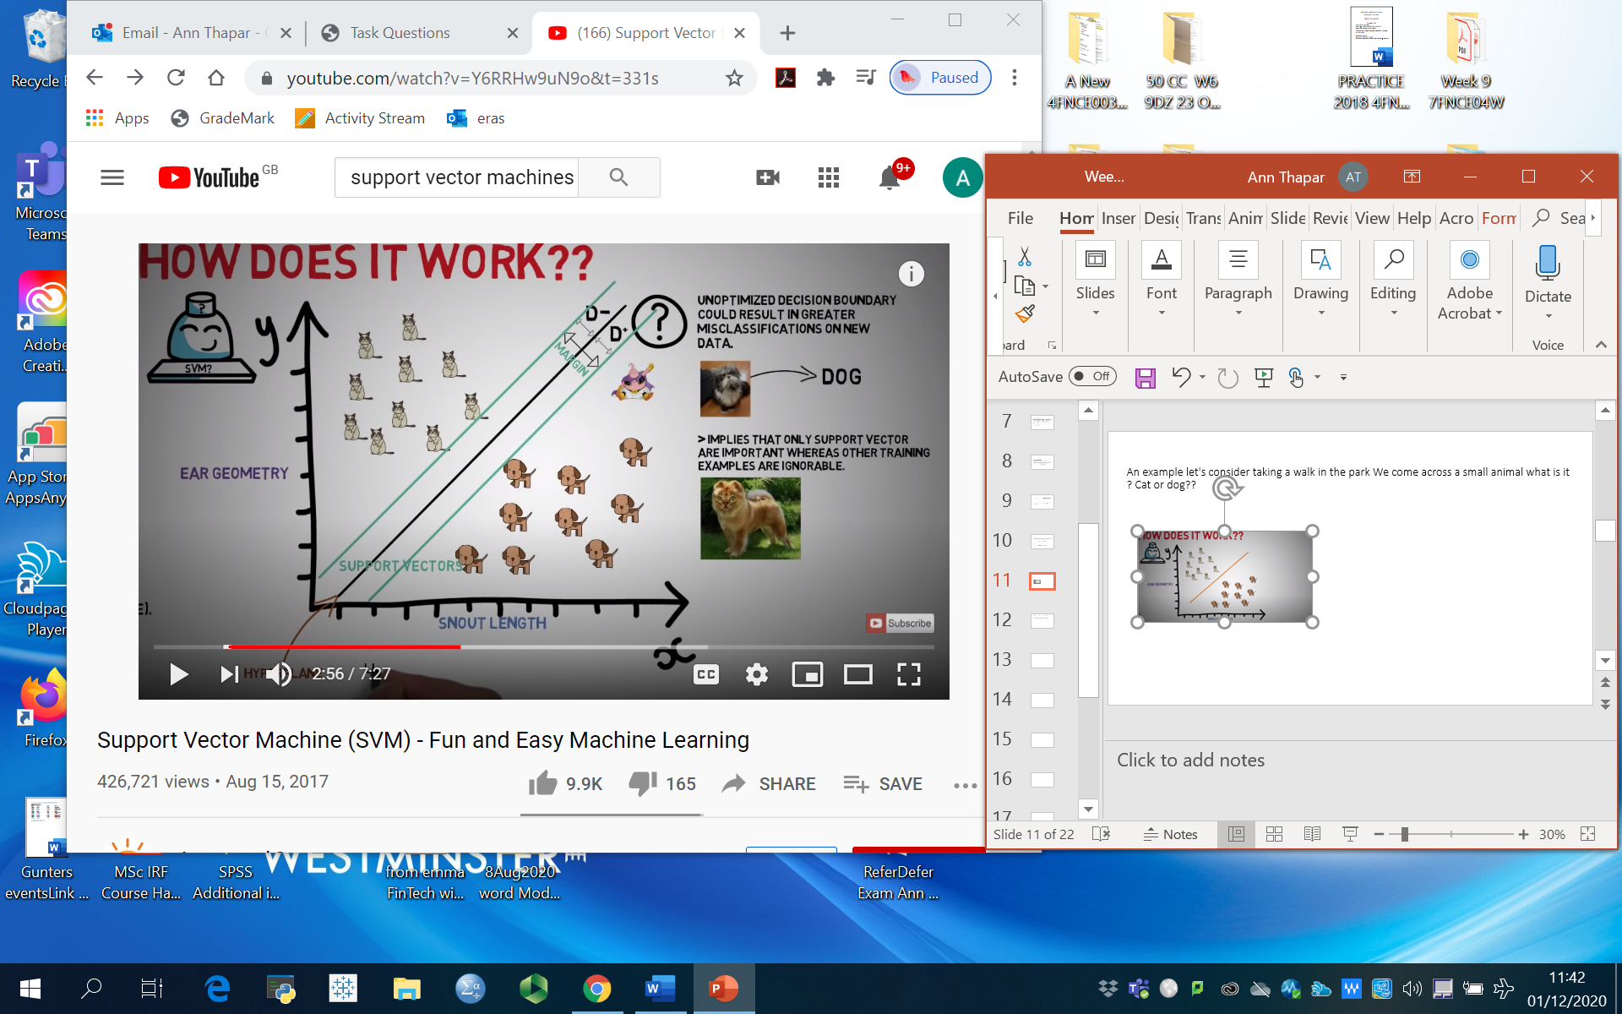
LINEAR SUPPORT VECTOR MACHINES An example let's consider taking a walk in the park We come across a small animal what is it ? Cat or dog?? .
Support vectors are data points which the margin pushes up against and which are close to the opposing class and used as boundaries
To set the extremes so we can clearly set the boundaries we define D+ and D- and margins of separating Hyperplane = D+ plus D-.
Notes:
Data points are called vectors as they have Coordinates within space.
A hyperplane is a boundary that separates data sets in more than one dimension in the case of 2 dimensions we can regard this as a straight line however in three dimensions it can be seen as a plane full stop

Slide 6
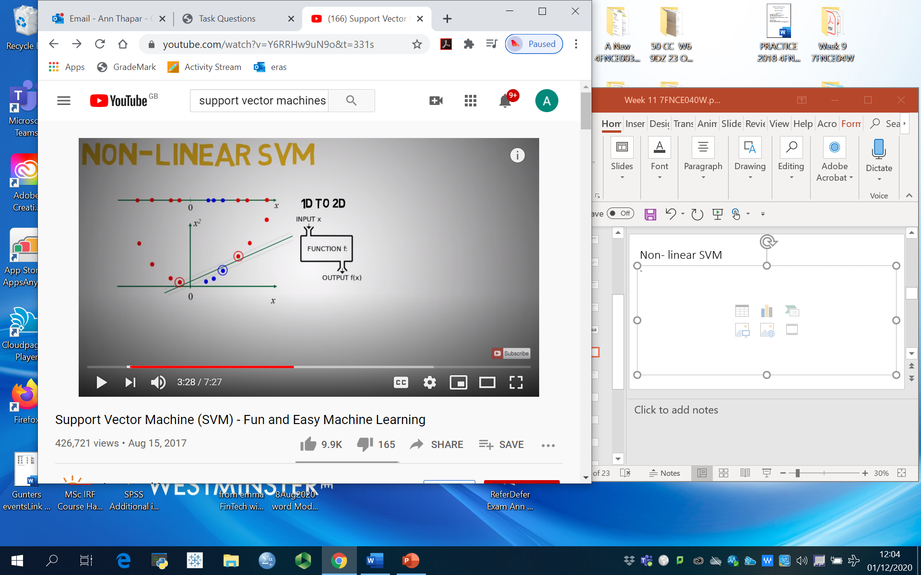
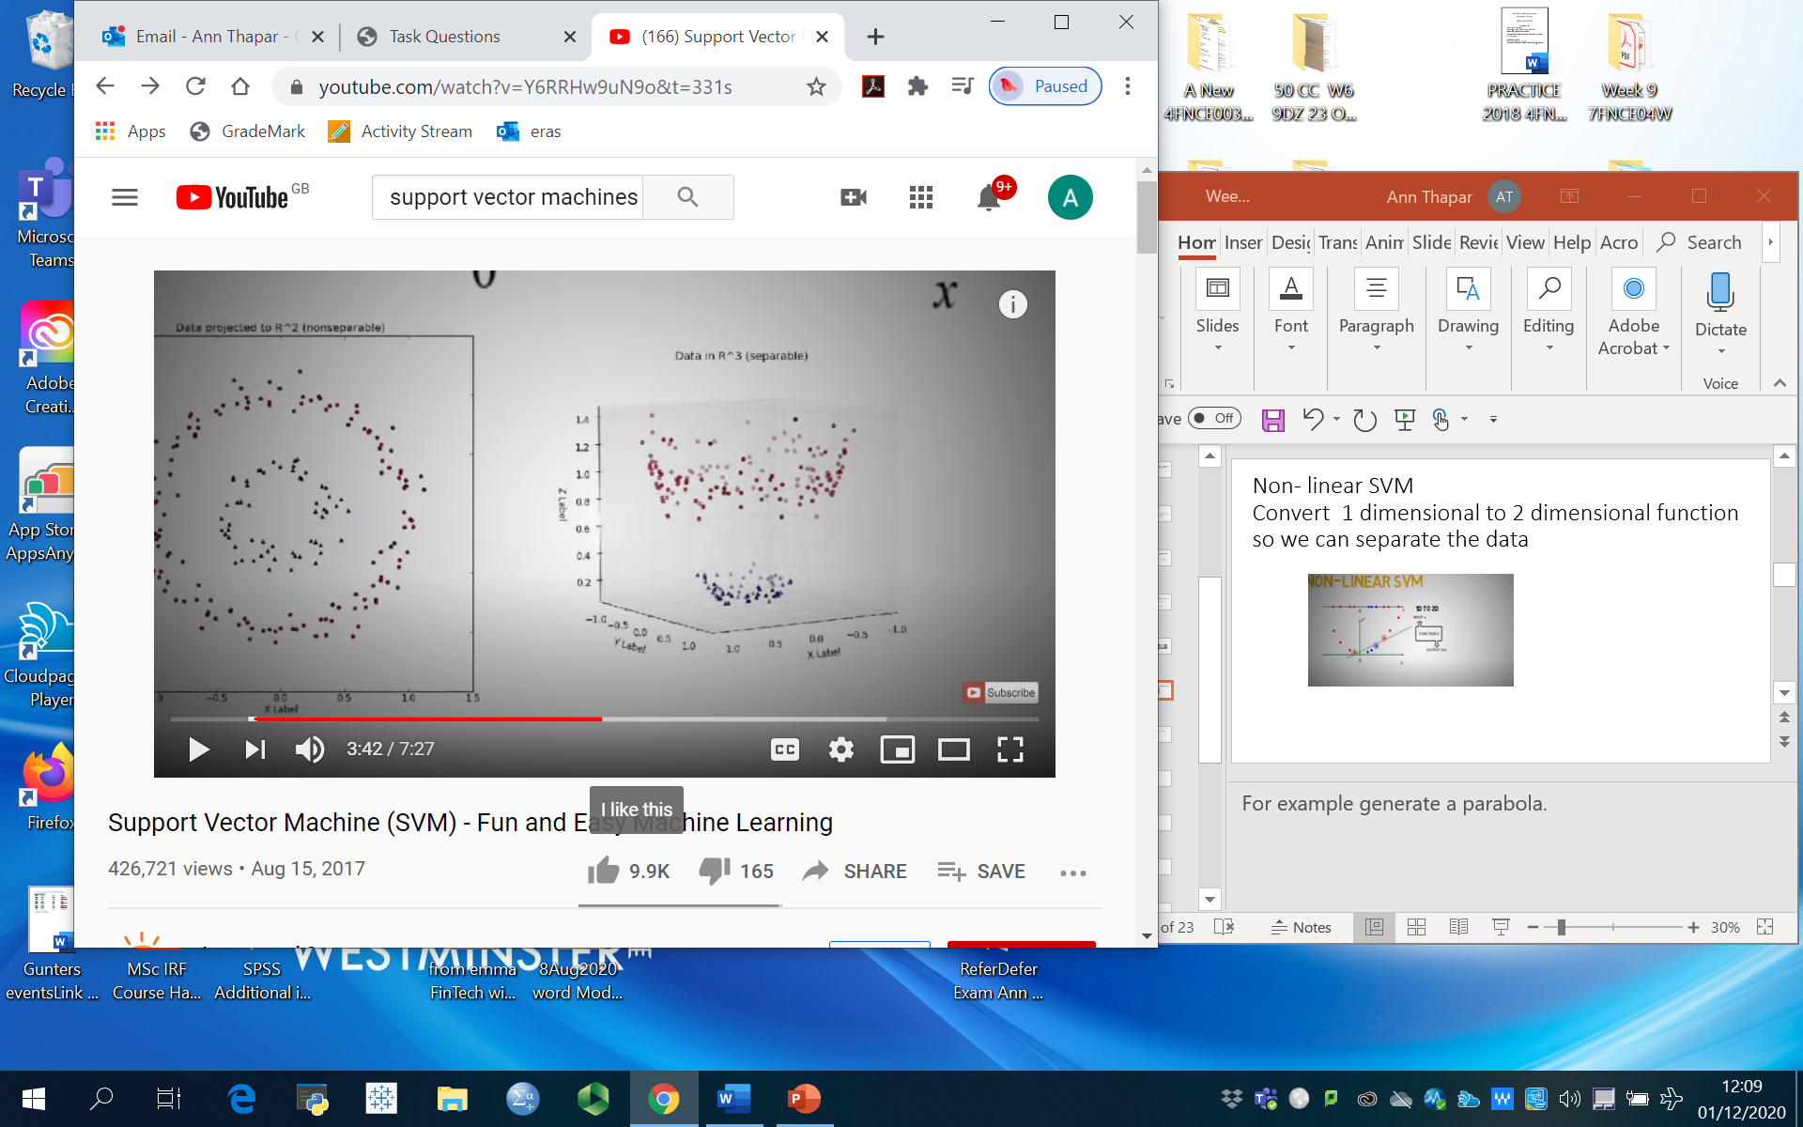
Non- linear SVM Convert 1 dimensional to 2 dimensional function so we can separate the data
Notes:
For example generate a parabola.
Or convert R^2 to R^3.
Note this is computationally expensive so we use KERNAL Trick to reduce the computational costs

Slide 7
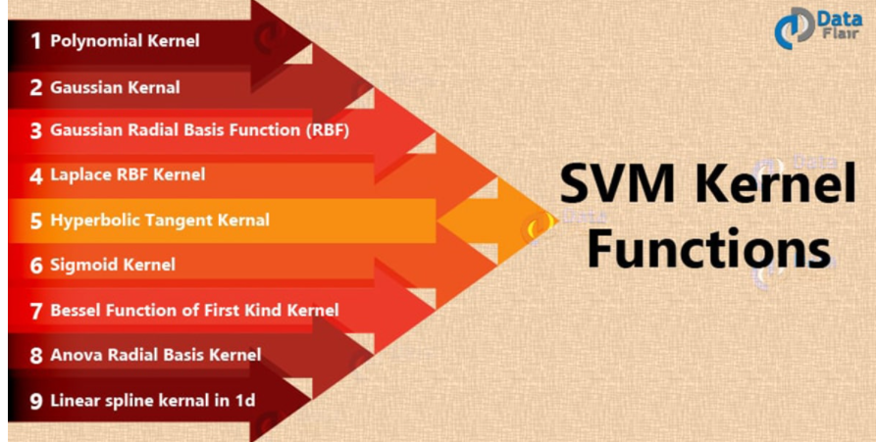
SVM Kernel Functions, Basically transforms non linear space into a linear space
SVM algorithms use a set of mathematical functions that are defined as the kernel. The function of kernel is to take data as input and transform it into the required form. Different SVM algorithms use different types of kernel functions. These functions can be different types. For example linear, nonlinear, polynomial, radial basis function (RBF), and sigmoid.

Slide 8
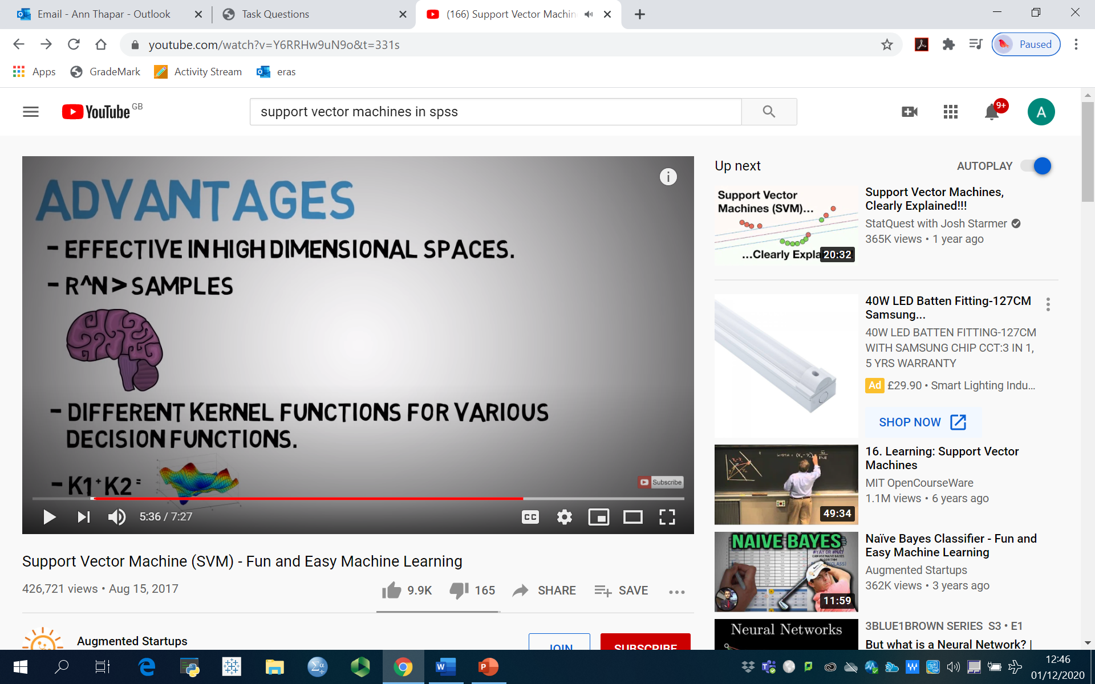
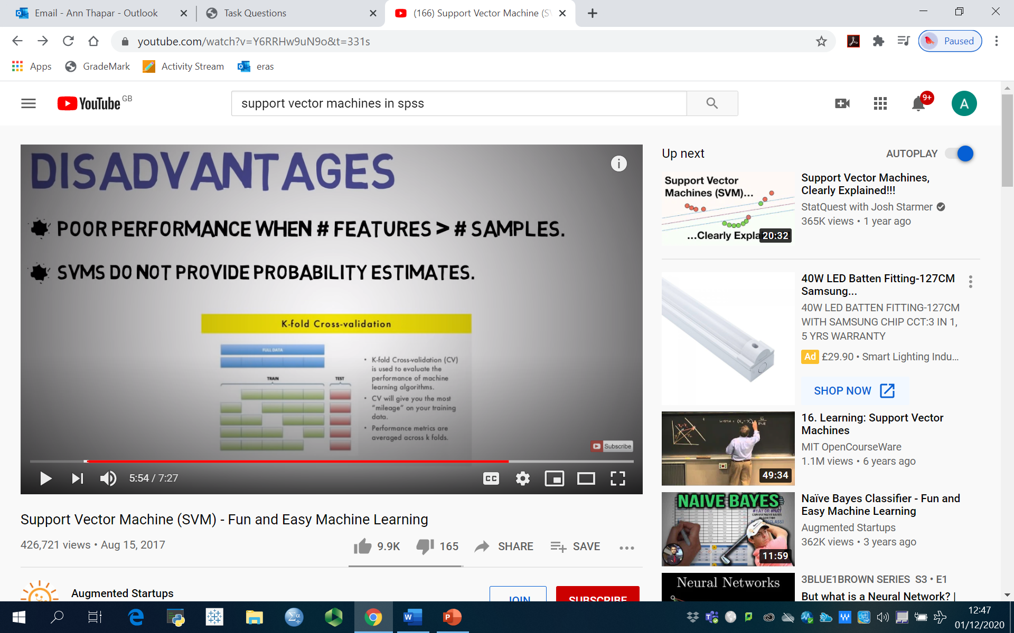
Advantages and Disadvantages
Notes:
Advantage-Where no of observations are greater than no of dimensions

Slide 9
What is Support Vector Machine (SVM) learning?
Support vector machine is another simple algorithm.
Support Vector Machine (SVM) is a classification and regression technique that is particularly suitable for wide datasets. A wide dataset is one with a large number of predictors, such as might be encountered in the field of bioinformatics (the application of information technology to biochemical and biological data).
The objective of the support vector machine algorithm is to find a hyperplane in an N-dimensional space(N — the number of features) that distinctly classifies the data points.

Slide 10
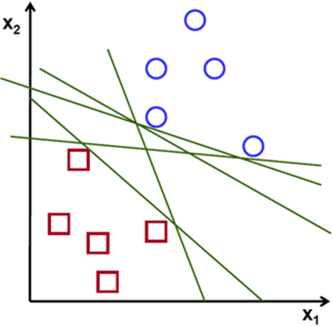
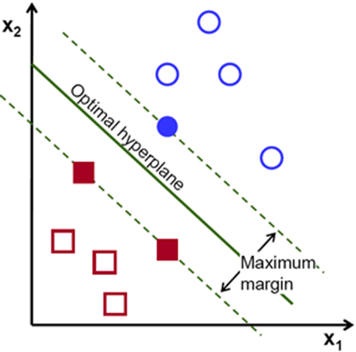
Possible hyperplanes
Notes:
To separate the two classes of data points, there are many possible hyperplanes that could be chosen. Our objective is to find a plane that has the maximum margin, i.e the maximum distance between data points of both classes. Maximizing the margin distance provides some reinforcement so that future data points can be classified with more confidence.

Slide 11
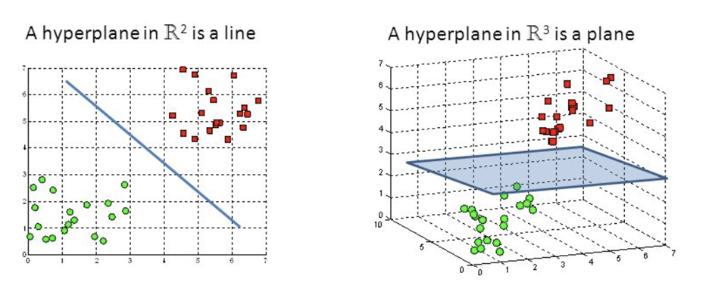
Hyperplanes and Support Vectors Hyperplanes are decision boundaries that help classify the data points.
Notes:
Hyperplanes are decision boundaries that help classify the data points. Data points falling on either side of the hyperplane can be attributed to different classes. Also, the dimension of the hyperplane depends upon the number of features. If the number of input features is 2, then the hyperplane is just a line. If the number of input features is 3, then the hyperplane becomes a two-dimensional plane. It becomes difficult to imagine when the number of features exceeds 3.

Slide 12
Support vectors
Support vectors are data points that are closer to the hyperplane and influence the position and orientation of the hyperplane. Using these support vectors, we maximize the margin of the classifier. Deleting the support vectors will change the position of the hyperplane. These are the points that help us build our SVM.

Slide 13
Large Margin Intuition
In logistic regression, we take the output of the linear function and squash the value within the range of [0,1] using the sigmoid function. If the squashed value is greater than a threshold value(0.5) we assign it a label 1, else we assign it a label 0. In SVM, we take the output of the linear function and if that output is greater than 1, we identify it with one class and if the output is -1, we identify is with another class. Since the threshold values are changed to 1 and -1 in SVM, we obtain this reinforcement range of values([-1,1]) which acts as margin.

Slide 14
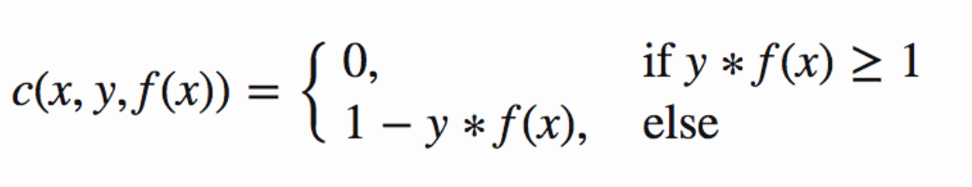
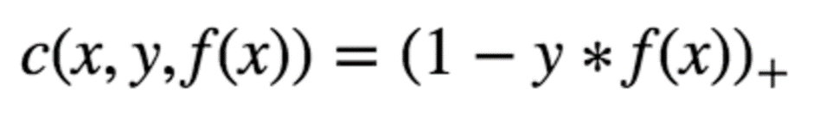
Mathematical Explanation of Theory
Cost Function and Gradient Updates
In the SVM algorithm, we are looking to maximize the margin between the data points and the hyperplane. The loss function that helps maximize the margin is hinge loss.
Hinge loss function (function on left can be represented as a function on the right)
Notes:
The cost is 0 if the predicted value and the actual value are of the same sign. If they are not, we then calculate the loss value. We also add a regularization parameter the cost function. The objective of the regularization parameter is to balance the margin maximization and loss.

Slide 15
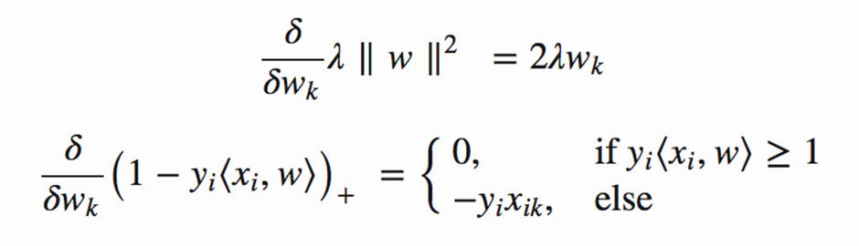
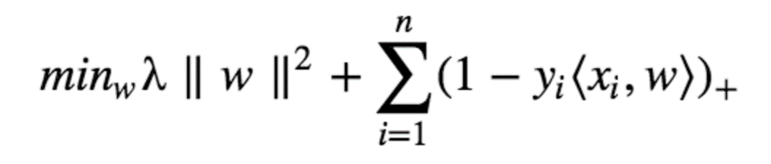
After adding the regularization parameter, the cost functions looks as below.
Now that we have the loss function, we take partial derivatives with respect to the weights to find the gradients. Using the gradients, we can update our weights.

Slide 16
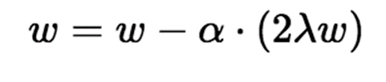
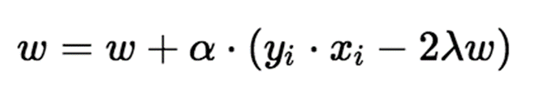
Gradients
When there is no misclassification, i.e our model correctly predicts the class of our data point, we only have to update the gradient from the regularization parameter.
When there is a misclassification, i.e our model make a mistake on the prediction of the class of our data point, we include the loss along with the regularization parameter to perform gradient update.
Notes:
We can use Python to implement our SVM algorithm.

Slide 17
Break

Slide 18
Discuss the group coursework

